Slide 1
JOB OPPORTUNITY ACROSS INDIA

Slide 2
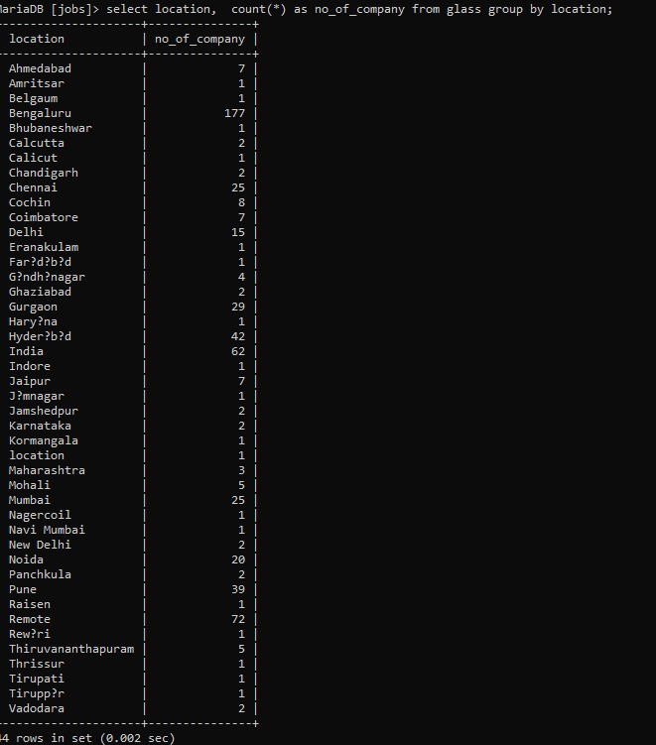
JOB OPPORTUNITY IN DIFFERENT CITY

Slide 3
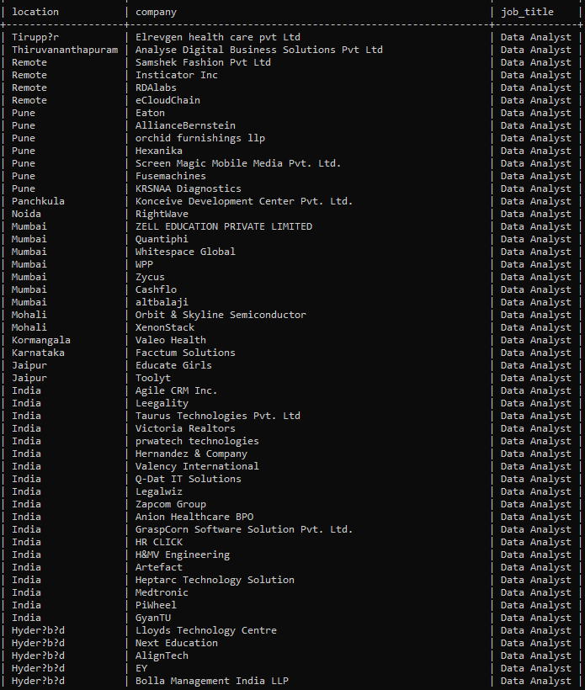
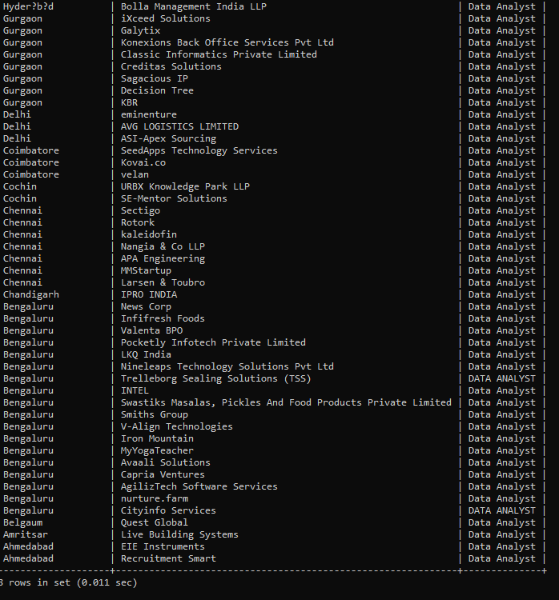
DATA ANALYST JOBS FROM DIFFERENT CITY IN DIFFERENT COMPANYS

Slide 4
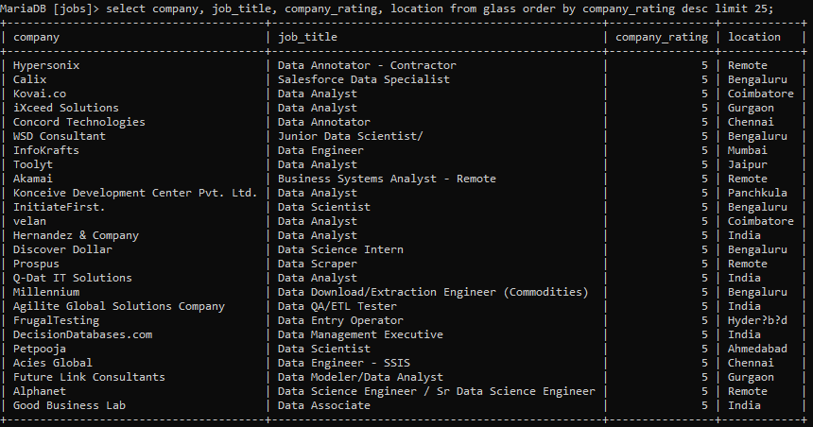
25 TOP RATED COMPANY

Slide 5
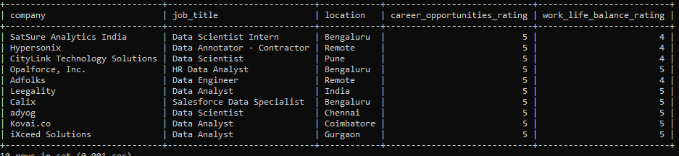
Top 10 companies to have

Slide 6
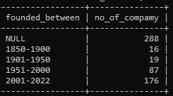
Most company’s founded in

